Slide 1
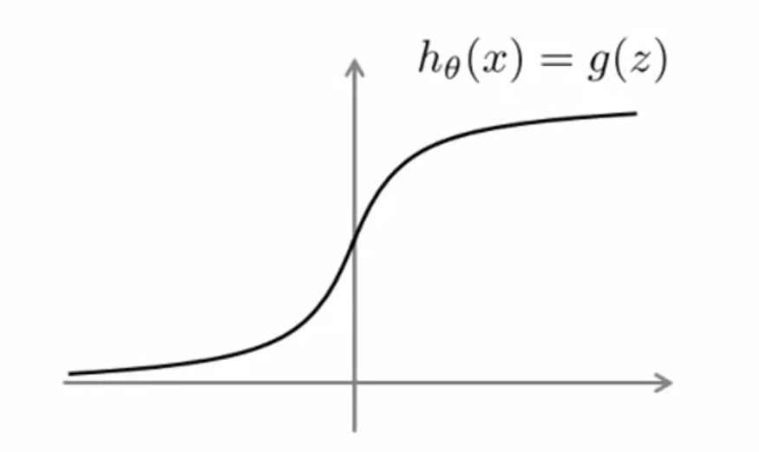
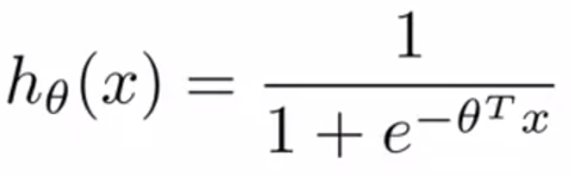
Optimization Objective
Alternative view of logistic regression

Slide 2
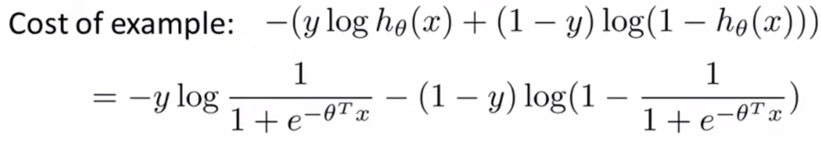
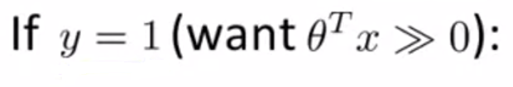
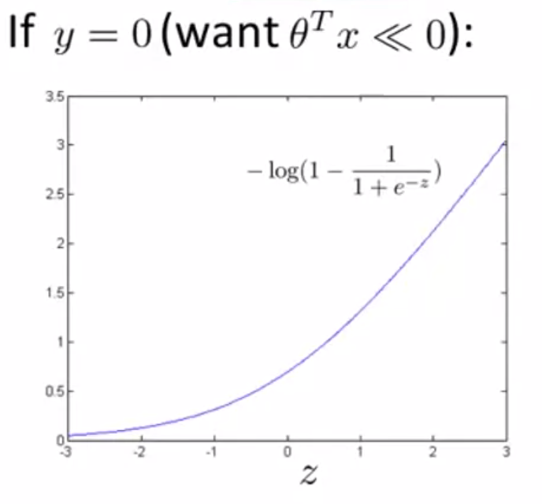
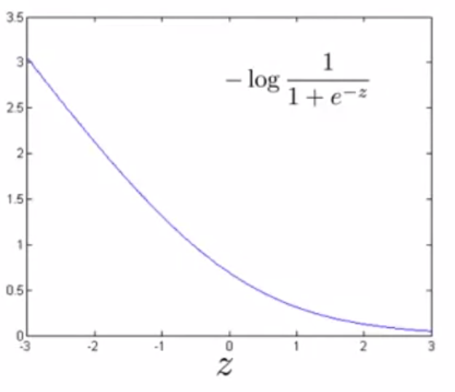

Slide 3
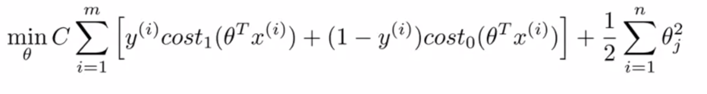

Hypothesis:

Slide 4
Support Vector Machines Large Margin Intuition

Slide 5
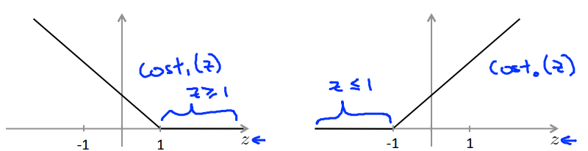

Support Vector Machine

Slide 6
Support Vector Machine

Slide 7
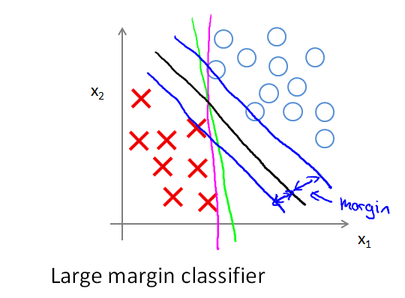
SVM Decision Boundary: Linearly separable

Slide 8
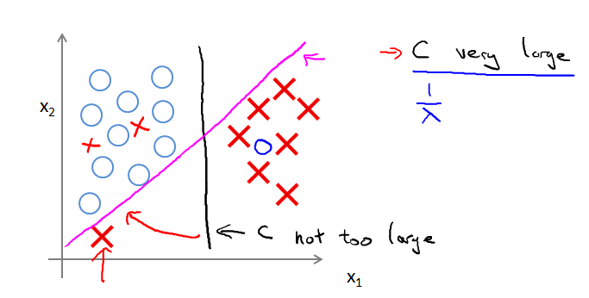
SVM Decision Boundary

Slide 9
Mathematics Behind Large Margin Classification
Hoa

Slide 10
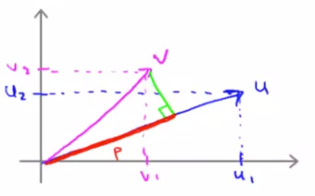
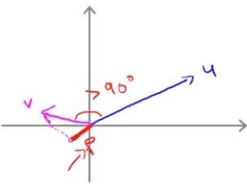

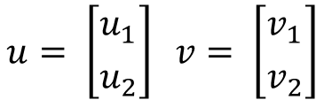

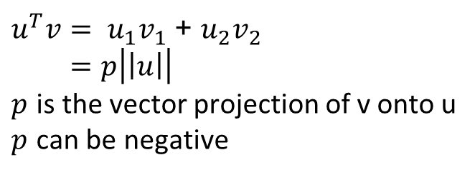
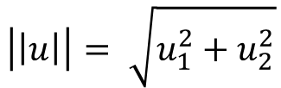
Vector Inner Product
$$u= \left[{u_{1} \atop u_{2}}\right] v= \left[{v_{1} \atop v_{2}}\right]$$
$$\left|\left|u\right|\right|= \sqrt{u_{1}^{2}+u_{2}^{2}}$$
$u^{T}v= u_{1}v_{1}$ + $u_{2}v_{2}$
$$=p\left|\left|u\right|\right|$$
$p$ is the vector projection of v onto u
$p$ can be negative
$$p>0$$
$$p<0$$

Slide 11

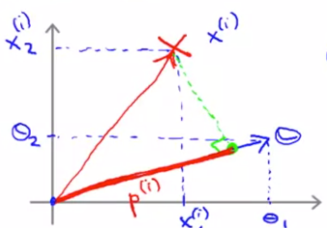
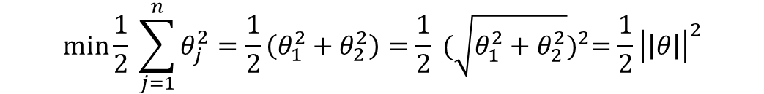

SVM Decision Boundary
$$\min{\frac{1}{2} \sum_{j=1}^{n}{θ_{j}^{2}}}=\frac{1}{2}\left(θ_{1}^{2}+θ_{2}^{2}\right)=\frac{1}{2} {(\sqrt{θ_{1}^{2}+θ_{2}^{2}})}^{2}=\frac{1}{2}{\left|\left|θ\right|\right|}^{2}$$
$$θ^{T}x^{(i)}= p^{(i)}|\left|θ\right||$$

Slide 12
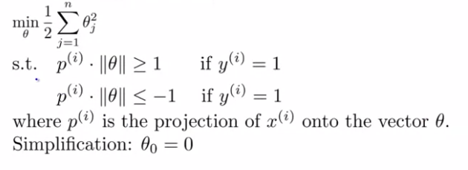
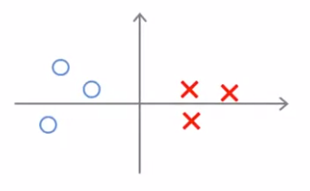
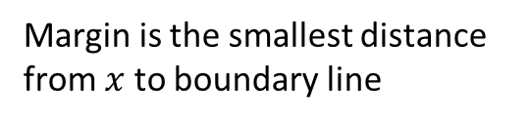
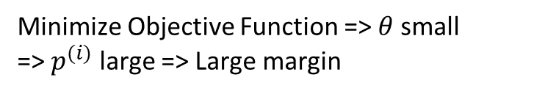



SVM Decision Boundary
Minimize Objective Function => $θ$ small
=> $p^{(i)}$ large => Large margin
Margin is the smallest distance from $x$ to boundary line
margin
$$p_{2}>0$$
$$\vec{θ}$$
$$p_{1}<0$$
Small margin
Large Margin

